Slide 1
Practice 7
Benjamin DAVID
B202200022

Slide 2
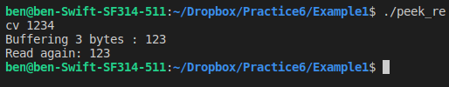
Example1

Slide 3

Example2

Slide 4

Example3

Slide 5
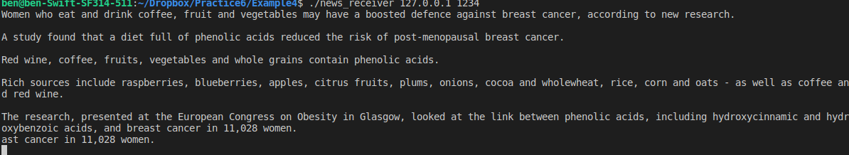
Example4
Sender
Receiver

Slide 6
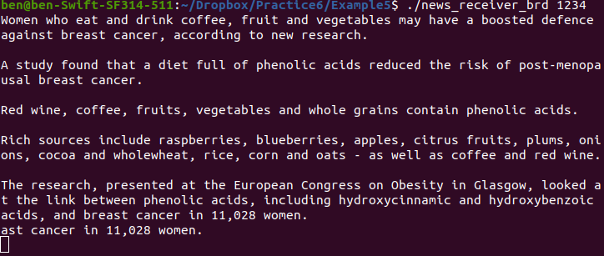
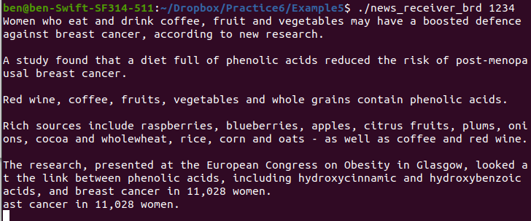
Example5
Sender
Sender Local Broadcast
Receiver
Receiver

Slide 7
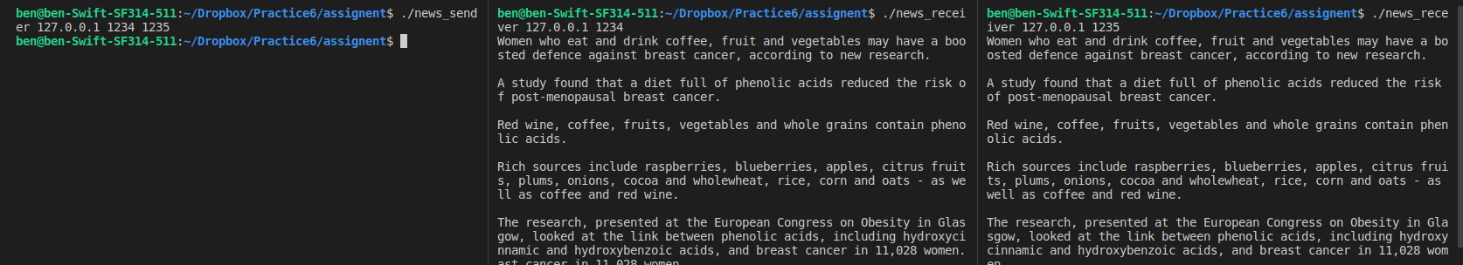
Assignment
Sender
Client 1
Client 2

